Slide 1
Build MVC apps with the Microsoft Graph .NET SDK
Build a ASP.NET web application using Microsoft Graph

Slide 2

Incorporate the Microsoft Graph into a web application
NuGet Packages
Authenticate with Azure AD
Create instance of the GraphServiceClient
Issue request and process results

Slide 3
NuGet Packages
Microsoft Graph .NET SDK
Microsoft.Graph
Notes:
Install-Package “Microsoft.Graph”
The Microsoft.Graph.Core package will be installed with Microsoft.Graph as a dependency, as will Newtonsoft.Json.

Slide 4
Obtaining a GraphServiceClient (API)
First, obtain an access token from Azure AD by authenticating:
public async Task<string> GetUserAccessTokenAsync()
{
IConfidentialClientApplication cca = ConfidentialClientApplicationBuilder.Create(appId)
.WithRedirectUri(redirectUri)
.WithClientSecret(appSecret)
.Build();
string signedInUserId = ClaimsPrincipal.Current.FindFirst(ClaimTypes.NameIdentifier).Value;
SessionTokenStore tokenStore = new SessionTokenStore(signedInUserId, HttpContext.Current);
tokenStore.Initialize(cca.UserTokenCache);
IEnumerable<IAccount> accounts = await cca.GetAccountsAsync();
var scopes = graphScopes.Split(' ');
var result = await cca.AcquireTokenSilent(scopes, accounts.FirstOrDefault())
.ExecuteAsync();
return result.AccessToken;
}

Slide 5
Obtaining a GraphServiceClient (API)
Then, use the access token to create an instance of the GraphServiceClient to call the Microsoft Graph API:
public static GraphServiceClient GetAuthenticatedClient()
{
DelegateAuthenticationProvider provider = new DelegateAuthenticationProvider(
async (requestMessage) => {
string accessToken = await SampleAuthProvider.Instance.GetUserAccessTokenAsync();
requestMessage.Headers.Authorization = new AuthenticationHeaderValue("bearer", accessToken);
});
GraphServiceClient graphClient = new GraphServiceClient(provider);
return graphClient;
}

Slide 6
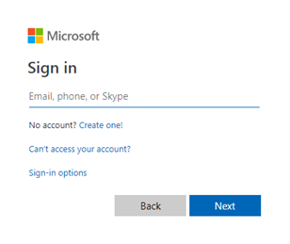
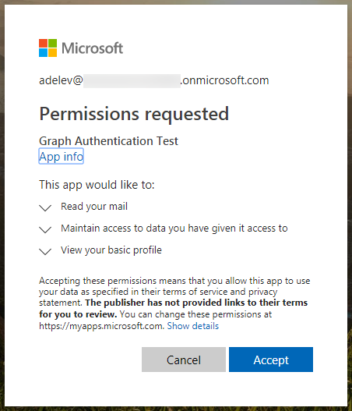
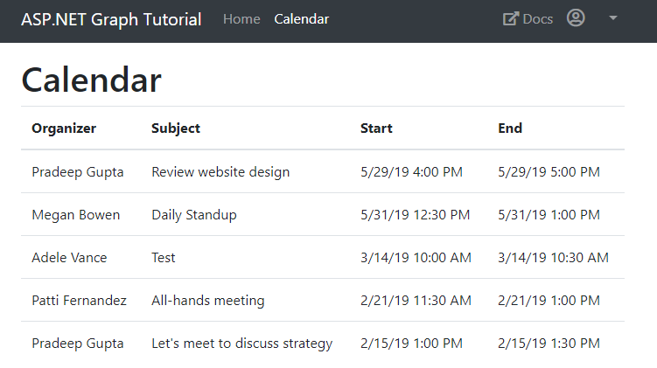
Application experience
User prompted to sign in
The user is prompted to sign in.
Prompt for consent
The user is prompted to grant consent to the application if admin consent was not already granted to the entire tenant.
Data from Microsoft Graph is returned
The Microsoft Graph API is queried and data is returned to the client.

Slide 7


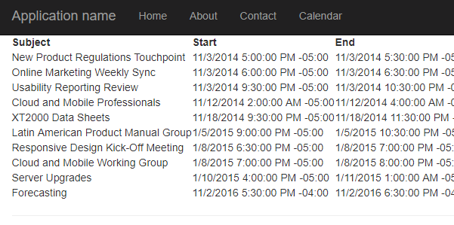
Overview of the sample
https://login.microsoftonline.com/
https://graph.microsoft.com
Sign in, get token
Teams
Groups
Access token
Tasks
Get calendar items
Chats
Calendar
Files
Calendar items
Insights
Microsoft Graph
Messages
Coworkers
User
Meetings
Devices
People

Slide 8
Authorization code grant and v2 endpoint
https://login.microsoftonline.com/common
Application
/common/OAuth/v2.0/authorize
/common/OAuth/v2.0/token
https://graph.microsoft.com
?scope=offline_access+openid+profile+User.Read+User.ReadBasic.All&response_type=code&client_id=…
Sign in, consent
authorization code
?scope=offline_access+openid+profile+User.Read+User.ReadBasic.All&grant_type=authorization_code&code=…
access_token, refresh_token, id_token
/v1.0/me (access token)
Current user’s profile
Token expires
?grant_type=refresh_token&refresh_token=…
access_token, refresh_token, id_token
/v1.0/me (access token)
Current user’s profile
Notes:
Once the access token is acquired, your application continues to call the Graph API without going through the steps to obtain an access token, it just caches it locally and keeps using it. At some point, the token expires. A refresh token is used to obtain a new access token without requiring the user to log in again.
To understand why the MSAL library is important, it’s necessary to understand what it is handling for you. Your code follows a simple pattern to acquire a token silently, and if that fails, acquire a token interactively. Your code does not need to manage the login pop up screen, the interaction for obtaining consent, and does not need to manage token lifetimes.
The call to /common/OAuth/v2.0/authorize will pop up a login screen and request permissions consent.
It is important to cache the refresh token to request a new access token. This is what the MSAL library does for you, there is no action for you as a developer to manage the refresh token. You can create a custom cache for persistence, but MSAL manages the token lifetime.
It is important, however, to understand what the library is doing.

Slide 9
Demo

Slide 10
Thank you.

